Slide 1
Management of Breast Cancer
DR M D P PINTO
LECTURER
DEPARTMENT OF SURGERY
FOM
UOK

Slide 2
Any cancer ….
Clinical, radiological confirmation
Tissue diagnosis
Staging
Curative or palliative

Slide 3
Triple assessment
Clinical
Radiological
Histological + receptor status – do all radiology before biopsy

Slide 4
Clinical -
History
Benign vs malignant
Risk factors (non modifiable and modifiable)
Compression
Metastasis
Lung – recent onset cough, haemoptysis
Bone – recent onset excruciating back pain which doesn’t respond to regular analgesics and disturbs sleep
Liver – lethargy, obstructive jaundice
Brain – recent onset fits, early morning headache
Examination
Breasts
Axillae
Liver, lung, bone – B/L lower limb neuro

Slide 5
Radiological
> 40y = mammogram
Younger breast more dense and mammographic interpretation difficult (more fibro glandular)
2 views = CC – craniocaudal/ MLO – medio-lateral-oblique
BIRADS classification
Spiculated lumps / calcifications
< 35y = USS
35 – 40y if suspicious = mammogram
Breast MRI
Indication;
pregnancy, equivocal mammo-USS results
Dense breast
High false positives →overtreatment
LN
Axillary, supraclavicular, inter-mammary
Mets = loss of fatty hilum

Slide 6
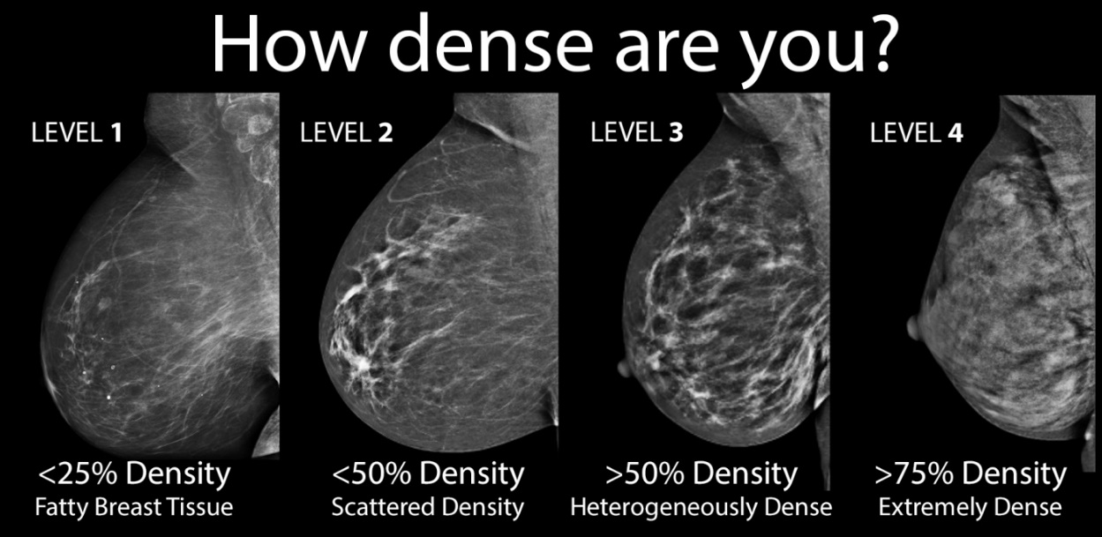
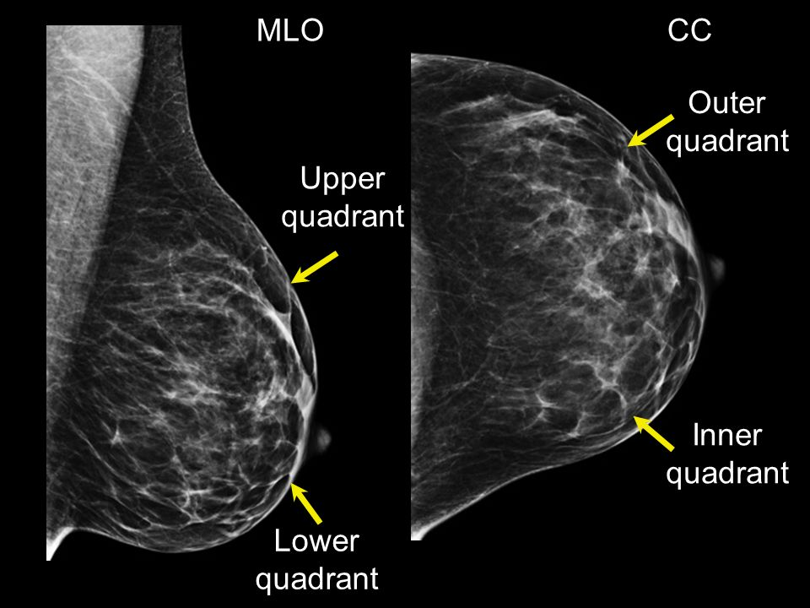
Mammogram
Digital x-ray → craniocaudal (CC) and medio-lateral-oblique (MLO) views
Comment on density of breast
Malignant lump
Irregular speculated border
Calcification – diffuse, branching
Benign lump
Well circumscribed
Cup like (ruptured cyst) or pop corn (fibroadenoma) calcifications
Benign parallel line calcifications - vessels

Slide 7
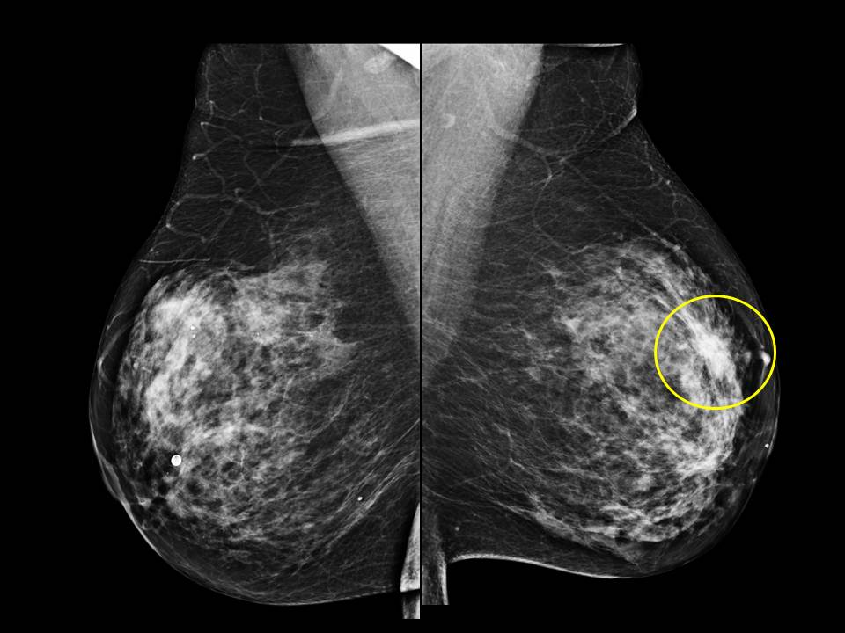
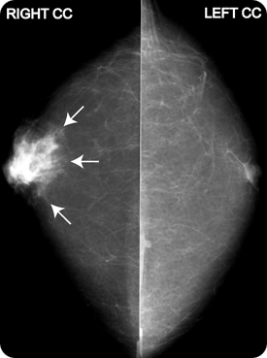
MALE BREAST CA

Slide 8
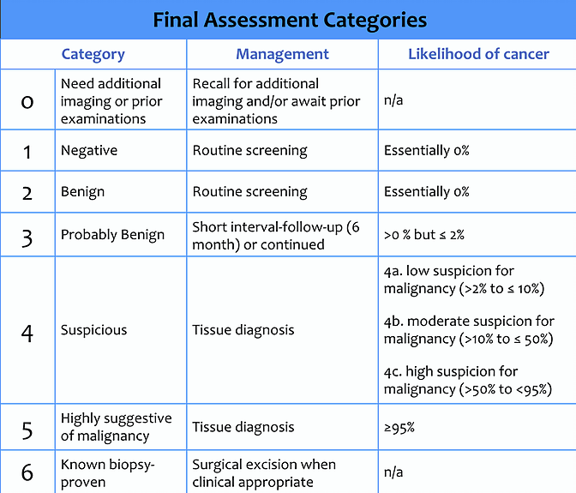
Breast imaging reporting and data systems

Slide 9
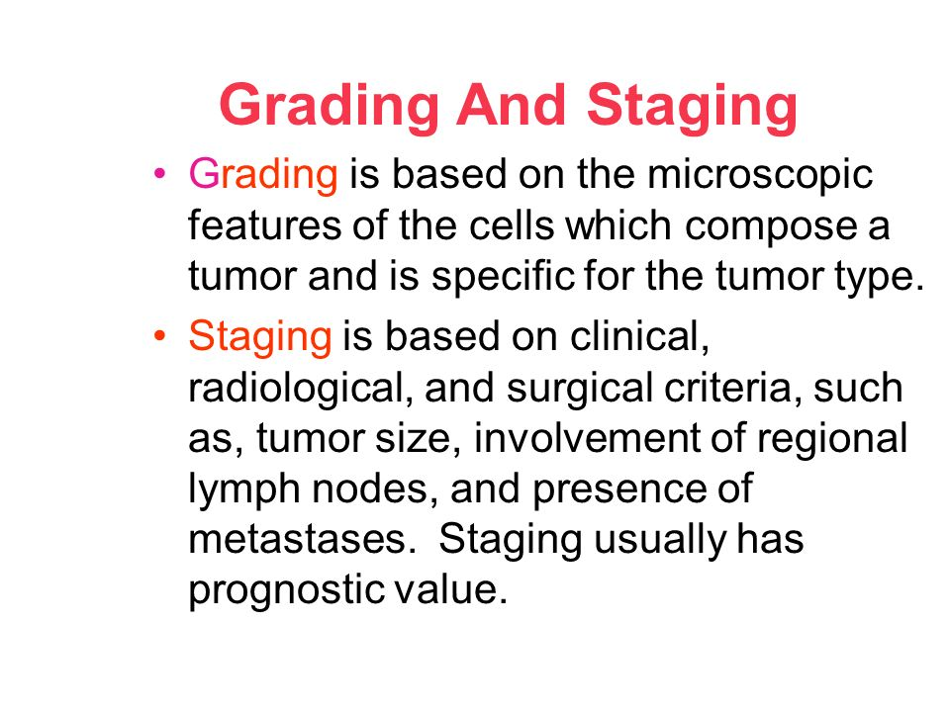
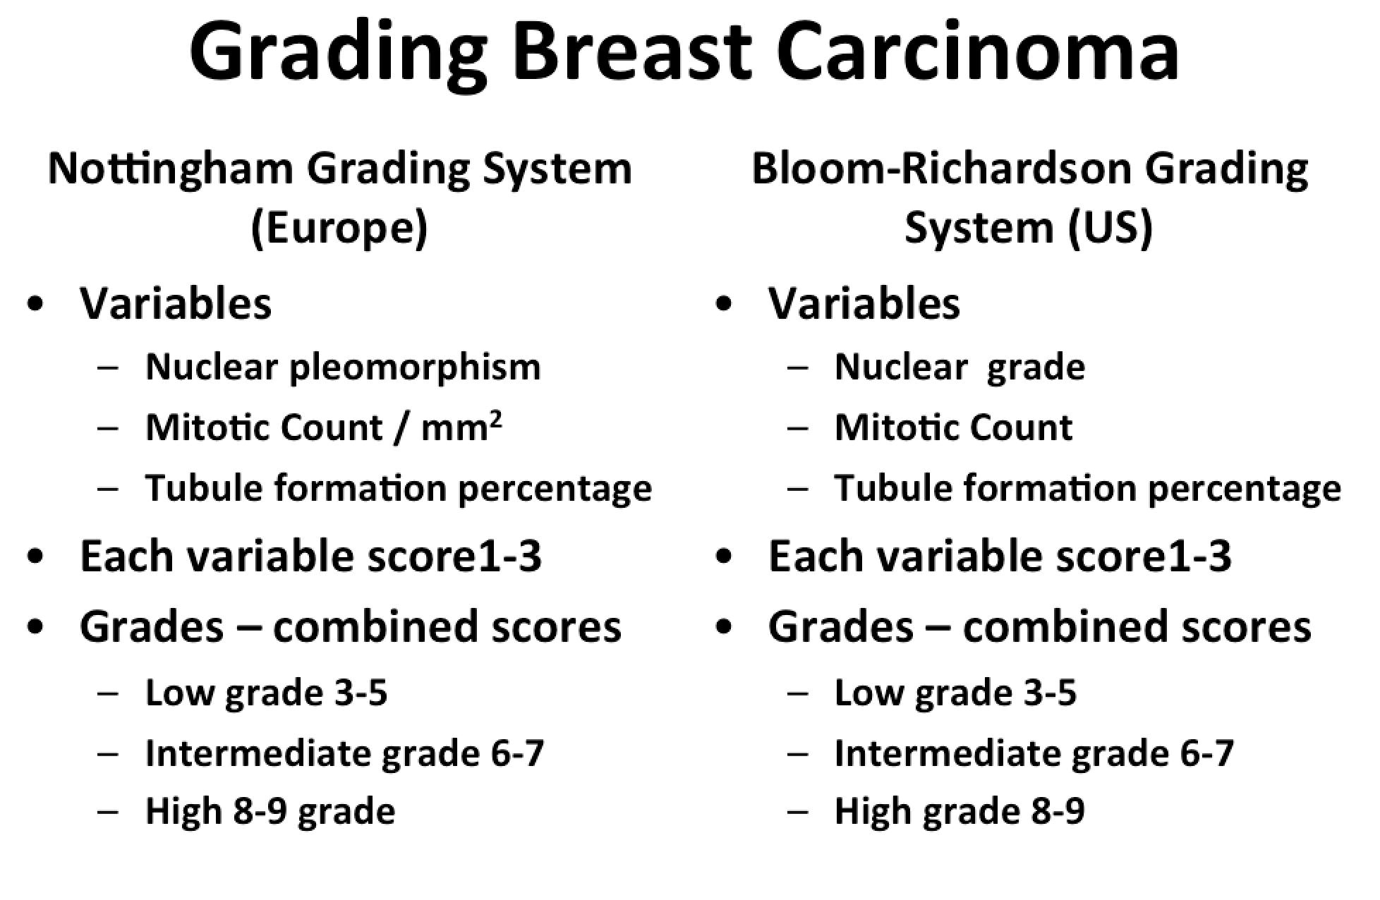
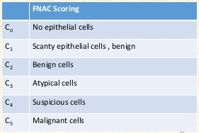
Tissue diagnosis
Core needle biopsy (CNB) > FNAC
More gain
Hormone receptor status
FNAC
Very small lesion
Lump at a difficult region (near an implant)
CNB
Day procedure under LA

Slide 10
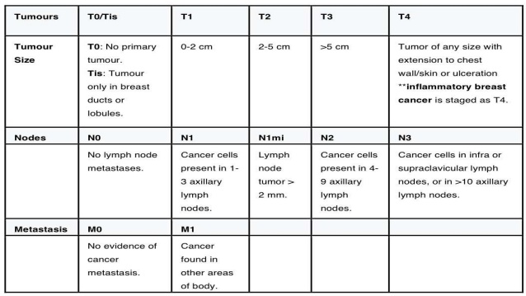
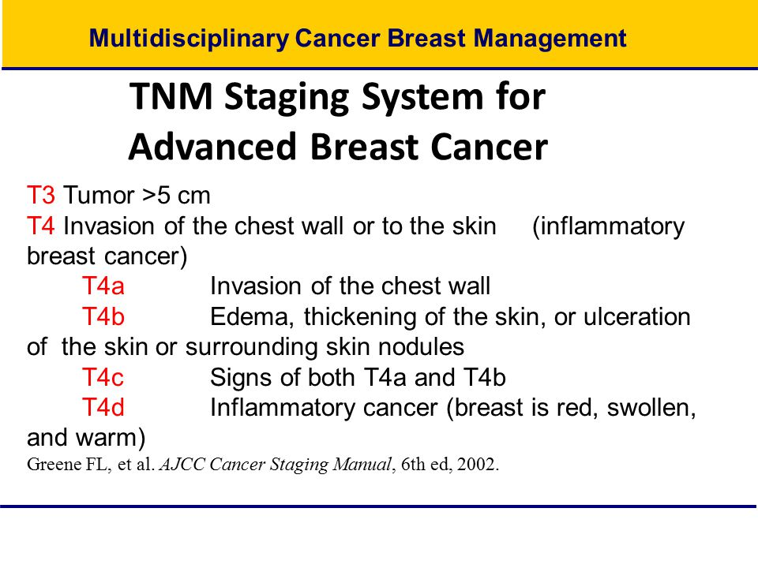
TNM

Slide 11
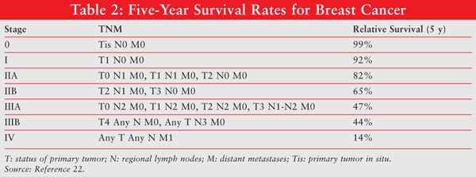
Staging

Slide 12
Categories
LCIS
DCIS
Up to T3N1M0
Locally advanced breast cancer (T4/stage III B,C and A except T3N1M0) –LABC
Metastatic breast cancer (MBC)

Slide 13
Treatment options
Neoadjuvant chemotherapy– preoperative treatment for down staging tumour
Indications
Make inoperable tumour (stage III B,C and A except T3N1M0) →operable
Sometimes disease progresses →palliative mode
Operable tumour MRM →reduce size and do BCS
Options CT/ ET

Slide 14
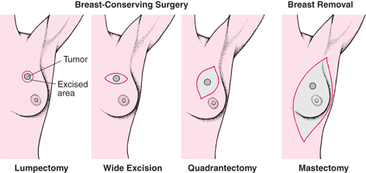
Treatment options
Surgery – curative intent
Breast conservation surgery (BCS) – always followed with WBRT (whole breast radiotherapy)
Wide local excision – lump vol : breast vol <20% - get margin of 1cm around lump
Oncoplastic surgeries – 20 – 40% - volume displacement
Implants / autogenous flaps - >40% - volume replacement
BCS contraindicated in;
Pregnancy = can’t give WBRT
If disease multicentric
If unicentric large >5cm
Previous RT

Slide 15
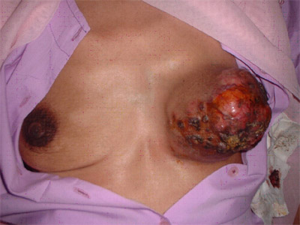
Treatment options
Mastectomy
Simple – breast only
Halsted radical – breast, pec minor and major and axillary nodes – very high morbidity – obsolete!
Modified radical – breast, pec major fascia, some axillary clearance – accepted – always offer reconstruction irrespective of age
Nipple sparing mastectomy – immediate reconstruction
Toilet mastectomy –Palliative intent – toilet mastectomy – previously done for T4b disease – now only a simple mastectomy done – mainly in stage IV to avoid problems of skin ulcer/ fungating tumour/ bleeding

Slide 16
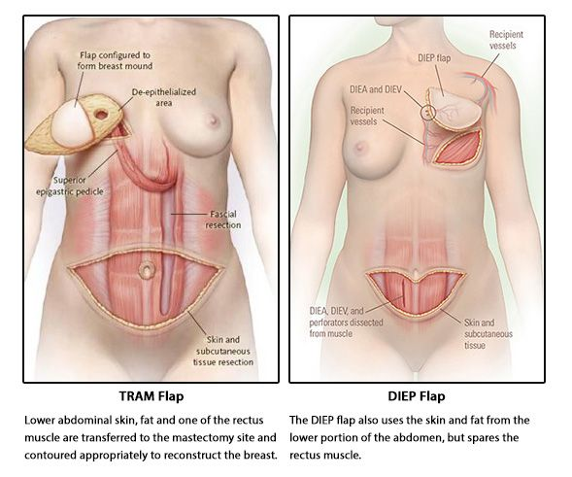
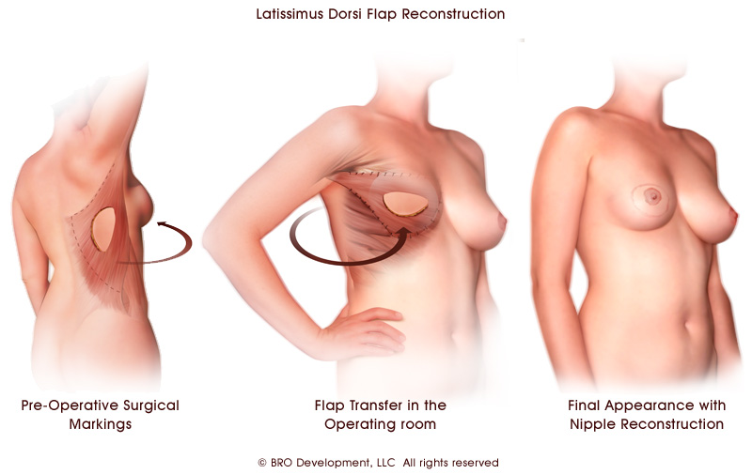
Treatment options
Breast reconstructive surgery (BRS) – immediate or delayed
Not in M1 disease where only palliation
types
Latissimus dorsi flap
Transverse rectus abdominis myocutaneous flap (TRAM)
Deep inferior epigastric perforator flap (DIEP)

Slide 17
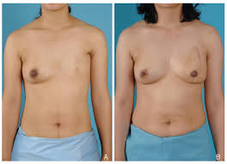
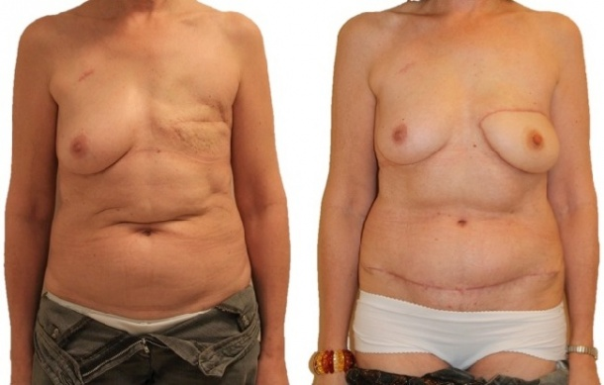
Delayed BRS

Slide 18
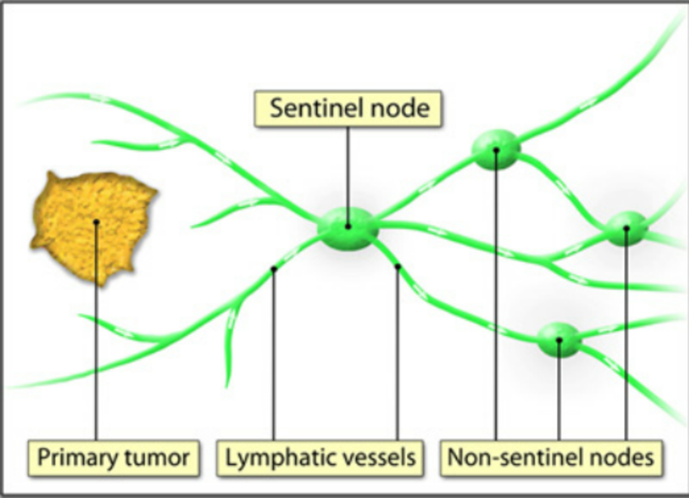
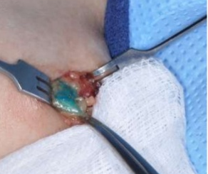
Treatment options
Axillary surgery
SLNB (sentinel lymph node biopsy)
Done when N0
Inject methylene blue (patent blue V dye) 15 min before or radio-isotope few hours before surgery – to the nipple (all lymph of breast drain to NAC lymph plexus and drain to axilla from there)
Using both ‘dual method’ gives better outcome
Take all colored or radiation detected nodes (minimum of 4) →frozen section →if macromets (>2mm) do ALND (up to level 2) OR if micromets (<2mm) or no mets do level I clearance only
if FZ negative but histopathology comes as mets → go back and clear level 2

Slide 19
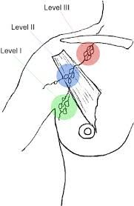
Treatment options
Axillary surgery
ALND – axillary lymph node dissection
Done when N1/2
Usually up to level 2
Remove rotter’s nodes in interpectoral fascia (between pectoralis major and minor)
Do level 3 only if gross nodes in level 2
At least 10 nodes should be cleared when a level 2 ALND is done

Slide 20
Treatment options - Adjuvant therapies
Chemotherapy (CT)
Several algorithms depending on recurrence estimation
By oncotype DX, DNA subtyping
Indications
N0 – check ER and tumour size before CT
Nodes positive disease
Agents
Anthracyclines, such as doxorubicin (Adriamycin) and epirubicin (Ellence)
Taxanes, such as paclitaxel (Taxol) and docetaxel (Taxotere)
5-fluorouracil (5-FU)
Cyclophosphamide

Slide 21
Treatment options - Adjuvant therapies
Endocrine therapy – for ER/PR/HER2
ER+
Tamoxifen – selective estrogen receptor modulator (SERM)
For premenopausal women – 2y following surgery→3y of AI
SE – DVT risk, endometrial CA
Other benefits – lowers cholesterol and CVS risk
Aromatase inhibtors (AI) – Anastrazole
In postmenopausal women estrogen from peripheral conversion
HER2 (human epidermal growth factor receptor 2) +
Trastuzumab, Pertuzumab
Can cause reduction in LV EF

Slide 22
Treatment options - Adjuvant therapies
Radio therapy
Reduces local recurrence by 66%
WBRT after BCS
Chest wall, scar, drain site RT after MRM
If N+ → target N3 regions
No RT if T1-2 and clear margin >1cm

Slide 23
LCIS – TisN0M0
Rare
Triple assessment – CNB
No treatment, only surveillance – mammo in 1year

Slide 24
DCIS – TisN0M0
Breast= WLE + WBRT (whole breast radio therapy) – cobalt 60
Do mastectomy;
If large unicentric >5cm
If multicentric – in 2 or more quadrants
Previous breast irradiation (can’t give WBRT again)
Axilla = SLNB → if positive go for ALND
ER+ - give Tamoxifen <60y, >60y aromatase inhibitors (AI)
No evidence on Trastuzumab if HER2 +

Slide 25
Invasive CA – stage I/II and IIIA T3N1M0
Breast
T1-2
BCS + WBRT
MRM if BCS contraindicated or patient wishes
T3
MRM
If less than 35y → BRCA 1/2 + →risk reduction contralateral mastectomy after MDT
Axilla
N1 /2 ALND
N0
SLNB →ALND
Immediate or delayed breast reconstruction
Adjuvant CRT + ET

Slide 26
Invasive CA – stage III (except IIIA T3N1M0)
Neoadjuvant CT/ET
If disease responds,
MRM + ALND with delayed BRS
BCS + ALND
Both has to have RT chest wall
If disease don’t respond and progresses while giving neoadjuvant,
Palliative mode →RT → Sx → CT/ET

Slide 27
Stage IV – M1
Brain mets
Excision/ RT
Bone mets
High ALP
Confirm by bone scintigraphy – high uptake
Skeletal related events
Pain – excruciating/unresponsive to NSAIDs/ disturbs sleep
Fractures
Cord compression
Hypercalcemia – mixed but predominantly osteoclastic
Treatment
Bisphosphonates
Denosumab
RT
Palliation
Symptom control
Improve quality of life
Toilet mastectomy + RT + CT/ET
Toilet mastectomy
Done to alleviate symptoms of fungating lump, ulcer, bleeding from lump
Simple mastectomy

Slide 28
Thank you
Questions?
askpinto@yahoo.com

